Slide 1
The School of Tourism and Hospitality
LEVERAGING STATE OWNED TOURISM ASSETS FOR BLACK SMME DEVELOPMENT: THE CASE OF STATE OWNED PARKS, LODGES AND ATTRACTIONS
FINAL REPORT
College of Business and Economics
15 March 2019

Slide 2
INTRODUCTION

Slide 3
Introduction
Focus of this project is to examine the use of a range of state-assets which have been identified by DoT in order to open up SMME opportunities for Black entrepreneurs.
Essentially, the project is examining two core issues.
The maximisation of the state assets for the direct engagement of black entrepreneurs in tourism.
The maximisation of the state assets for the indirect engagement of black entrepreneurs through tourism supply chains, including through leveraging of public procurement.

Slide 4
POLICY CONTEXT: Inclusive Tourism

Slide 5
Policy Context : Inclusive Tourism
One growing foci of debate in international tourism research is around the extent to which the sector is ‘inclusive’ (Bakker and Messerli, 2017; Scheyvens and Biddulph, 2018) and of identifying drivers or constraints to tourism-driven inclusive growth (Bakker, 2018; Biddulph, 2018; Campos et al., 2018; Hampton et al., 2018).
In the upsurge of international research around economic inclusion and tourism the South Africa case is of major interest because of several pronouncements made by DoT about the imperative for creating more inclusion in the tourism economy.

Slide 6
Policy Context : Inclusive Tourism
In several pronouncements offered during 2015 by Minister of Tourism considerable attention is accorded to issues of inclusion in the tourism sector and of national government’s understanding of the concept.
In March 2015 the Minister declared “tourism is not only about the activity of tourism” rather “it is about inclusive economic growth and the better life that it creates for those most in need” (Hanekom, 2015a: 1).

Slide 7
Policy Context: Inclusive Tourism
In addressing a major conference of tourism stakeholders in August 2015, the Minister proclaimed that among three key objectives of the country’s tourism policy in future was “very importantly we want to make the entire sector more inclusive and representative by bringing people who have been marginalized into the mainstream tourism economy” (Hanekom, 2015b: 2).
In another statement the two core “strategic imperatives” for South African tourism were identified as ‘greater sustainability’ and ‘greater inclusivity’ (Hanekom, 2015c: 1).
Inclusive tourism is thus on the international tourism agenda and firmly on the South African policy agenda

Slide 8
POLICY CONTEXT: Black SMME Development in Tourism

Slide 9
Policy Context: Black SMME Development in Tourism
At the heart of achieving inclusive tourism in South Africa is to expand the participation of Black entrepreneurs in the tourism economy either directly as entrepreneurs or indirectly as suppliers in value chains linked to tourism.
Promotion of SMME development as a whole – particularly for Black-owned SMMEs – has been a policy focus since 1995.
The major policy focus has been on direct SUPPLY-SIDE interventions which have included increasing financial support, training and advice for SMME development.

Slide 10
Policy Context: Black SMME Development in Tourism
The creation of new market opportunities for SMMEs is one of the central challenges for building the SMME economy in South Africa (Osiba Research, 2011). This is acknowledged in several policy commitments made by the Department of Small Business Development for SMME development as a whole and by the National Department of Tourism for pronouncements for transforming the tourism sector.
In terms of opening markets initiatives have involved fostering market linkages between SMMEs and large corporates, including most recently through encouraging private sector supplier diversity initiatives (Herrington and Overmeyer, 2006; Rogerson, 2012).

Slide 11
Policy Context: Black SMME Development in Tourism
It is generally acknowledged, however, that the results of a range of several different government initiatives to support business development in the SMME economy of post-apartheid South Africa have been somewhat disappointing (Rogerson, 2004).
Accordingly, in recent years national government has been searching for alternative pathways and policy initiatives in order to catalyse the SMME economy.

Slide 12
Policy Context: Black SMME Development in Tourism
Essentially, these alternative pathways include a focus on direct DEMAND-DRIVEN initiatives such as those directed at fostering entrepreneurship and SMME development through leveraging state assets and through state procurement programmes as opposed to the emphasis given in early SMME policy interventions which were largely supply-driven in character.
Tourism SMMEs have been a specific policy focus in recent years.
Over the two past decades, national government has introduced a range of initiatives to deepen SMME development in tourism, wider objectives of transformation and of moving towards inclusive growth (Rogerson, 2008b).

Slide 13
Policy Context: Black SMME Development in Tourism
The activities of the Tourism Enterprise Programme (TEP) which provided SMMEs with skills development, market access and business support advice.
More recent interventions have included the Tourism Support Programme (TSP), a DTI financing initiative which was a sub-programme of the Enterprise Investment Programme launched in 2008. In 2012 administration of this programme moved from DTI to NDT; the TSP offers a reimbursable cash grant towards investment costs for establishing or expanding existing tourism operations including accommodation and tour operators.

Slide 14
PROJECT BEGINNING

Slide 15
Project Beginning
During 2017 the Tourism Minister announced a further government backed tourism development fund to support SMMEs, including community-based projects, as part of strategic planning for inclusive growth
Other useful programmatic interventions have encompassed assistance for the establishment or operations of tourism business incubators, which link to a major push by DSBD for incubators as a whole.
The impact of this raft of recent initiatives remains to be evaluated.

Slide 16
Project Beginning
There is growing interest on behalf of the DoT to complement these supply-side support interventions with a suite of demand-driven initiatives and one significant facet of fresh policy thinking towards demand-side interventions is consideration that is being given to leverage the potential of state-owned assets for tourism development and for SMME upgrading
A first step towards achieving this objective has been the undertaking of a national audit of such state assets.
The DoT engaged with stakeholders and compiled a partial list of state-owned assets in terms of state-owned land, lodges and attractions.

Slide 17
Project Beginning
These assets include those of national and provincial government as well as an array of municipal assets.
The maximisation of these state assets can be potentially critical vehicles for assisting tourism-led Local Economic Development and for an exploratory analysis of the potential for leveraging state assets for inclusive growth, transformation and expanding the role of black entrepreneurs in the tourism sector of South Africa.

Slide 18
PROJECT BEGINNING: What are These State Assets?

Slide 19
What are These State Assets?
Arguably, the most significant of these assets include those of SANparks, North West Parks and Cape Nature.
Nevertheless, one must not overlook the large number of often smaller MUNICIPAL ASSETS which can include local nature reserves, accommodation complexes, camp sites, caravan parks and even a number of lighthouses.
A broad indicator of the range and character of municipal assets that might be leveraged for tourism development can be gleaned from an analysis of municipal assets listed for two provinces in the Department of Tourism’s dataset.

Slide 20
What are These State Assets?
The choice of Western Cape and Eastern Cape provinces is influenced by the quality of responses received from its various municipalities about the nature of their local assets that might be leveraged for tourism development.
Although the listings are far from complete the findings should be seen as indicative of the most common forms of state asset that might be leveraged.

Slide 21
Table 1: State Assets by Category: Western Cape
Type of Asset | Number
Nature reserve | 28
Holiday resorts | 22
Camping or Caravan Park | 15
Museum | 7
Heritage site | 7
Botanical or Nature Garden | 6
Harbours | 5
Beach | 5
Visitor Centre | 5
Historic view site | 1
Research Conservation Centre | 1
Cultural Centre | 1
Community farm | 1
Hiking trail | 1
Lighthouse | 1

Slide 22
Table 2: State Assets by Category: Eastern Cape
Type of Asset | Number
Nature reserve | 35
Heritage site | 16
Camping or Caravan Park | 14
Conference facility | 10
Dams | 9
Beach | 7
Museum | 6
Visitor Centre | 6
Arts Centre | 6
River | 6
Botanical Garden | 4
Stadium | 4
Holiday Resorts | 3
Hiking trail | 2
Water Falls | 2
Cultural Village | 1
Aquarium | 1
Zoo | 1
Harbour | 1
Bowling | 1

Slide 23
What are These State Assets?
Overall, there is variability across the country with the state assets
The “jewels in the crown” are national parks.
At municipal level we see a mix of assets from the evidence from Western Cape and Eastern Cape.
The asset base is broad as is indicated also from other provinces which list also a range of conference centres, dams, zoo, aquarium, sports stadia, picnic sites.

Slide 24
What are These State Assets?
Arguably, however, across the reporting provinces and on the basis of the existing limited data, the most common forms of municipal assets that might be leveraged for tourism relate to nature reserves, holiday resorts, camping and caravan parks, museums and heritage sites, botanical or nature gardens, harbours and beaches.

Slide 25
UJ PROJECT

Slide 26
UJ Project
The UJ project is planned for 3 years and involves a range of investigations around maximisation of these state assets.
Year One has two research foci.
Maximising one big state asset in terms of nature reserve (Pilanesberg)
A municipal/locality study to analyse the leveraging of a variety of local municipal assets in one municipality (Overstrand)
KEY RESEARCH QUESTION:
maximising state assets directly or indirectly for inclusive growth and deeper engagement of black SMMEs.

Slide 28
THE OVERSTRAND STUDY

Slide 29
The Overstrand Study
The choice of this local municipality was based upon several factors:
the comprehensive detail of the listing of state assets as provided for this Local Municipality in the NDT data base;
Overstrand one of the 10 most tourism dependent municipalities in the country
the importance of leveraging state assets for more inclusive tourism development in view of civil disturbances during 2018 in the municipal area part of which were fuelled by absence of economic livelihood opportunities.

Slide 30
The Overstrand Study
It is evident that resident protests and disturbances were underpinned by the absence of affordable housing in the area and (relatively) high levels of local unemployment estimated as 23 percent for Overstrand as a whole but with youth unemployment exceeding 30 percent.
One estimate of the economic damage caused by the 2018 civil protest and unrest is at least R400 million.

Slide 31
THE OVERSTRAND STUDY: Key Findings

Slide 32
Overstrand Key Findings - Lack of Inclusion
Our findings reveal that the Overstrand tourism is not inclusive.
In terms of accommodation services shows its ‘exclusive’ character in terms of ownership of key tourism assets by small corporates, independent hotel operators and a large number of tourism SMMEs operated by white entrepreneurs.
In tour services and restaurants/dining sector the story is of continued overwhelming white ownership.
The only exceptions are one black owned bed and breakfast establishment in Zwelihle (now closed), one local DJ and young entrepreneur who is seeking to develop the entertainment industry, one tour service operator and one CBE a restaurant at the penguin colony.

Slide 33
Overstrand Key Findings - Lack of Inclusion
The fine dining country establishments and boutique offerings as well as the majority of local restaurants geared to visitors are white-owned and operated.
In adventure tourism, wine estates it is a familiar pattern of white ownership of the enterprises which are associated with these attractions.
The Coloured and black communities of the Overstrand are represented in the tourism sector almost exclusively as workers rather than as entrepreneurs.

Slide 34
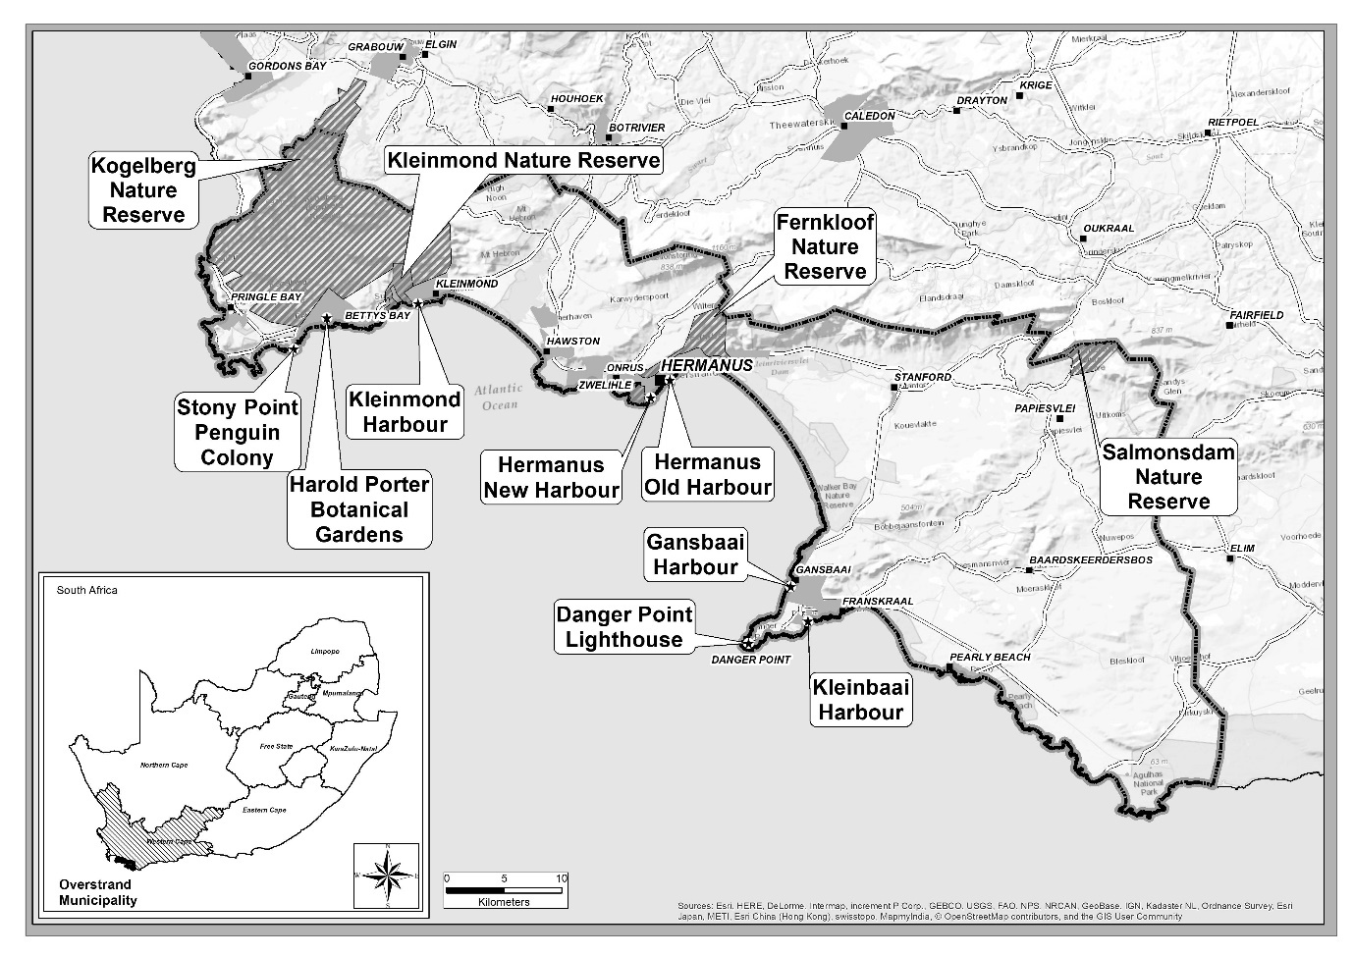

Slide 35
Overstrand Key Findings - Using and Not Using State Assets
On TripAdvisor several of the ‘top things to do’ in the Overstrand actually relate to state assets.
The stakeholder interviews as well as documentary sources disclosed the significant finding that in recent years several initiatives for building a more inclusive Overstrand tourism economy have been launched in terms of project proposals by many different institutional actors.
BUT: Few successes, however, have been recorded in terms of expanding the direct participation of members of marginalised communities for tourism SMME development.

Slide 36
Overstrand Key Findings - Using and Not Using State Assets
During the early 2000s are the series of thwarted planning initiatives targeted at broadening the engagement of entrepreneurs from previously disadvantaged communities in local tourism relating to the activities of the Overstrand Local Economic Development Agency or OLEDA, which was a “private company owned by the Overstrand Municipality”.
Notwithstanding the rich potential development opportunities identified by OLEDA for tourism as a whole in the Overstrand and especially for leveraging business opportunities for members of previously disadvantaged communities, little progress occurred.

Slide 37
Overstrand Key Findings - Using and Not Using State Assets
With the ending of OLEDA the focus is upon direct municipal led initiatives and other tourism development proposals which offer potential entrepreneurial opportunities for residents from local previously disadvantaged communities.
Once again we have in the report a catalogue of missed opportunities in terms of projects to use state assets
These responses point to the municipality’s lack of entrepreneurialism towards business development and instead preferring that its LED operations be focused squarely on poverty alleviation projects.

Slide 38
Overstrand Key Findings - Using and Not Using State Assets
From the perspective of private sector, the municipality:
“don’t take LED seriously”,
“do not understand the tourism economy”,
“do not know how to facilitate things” for private investment, and
the town planning department is “a tourism hindrance as business plans either can take over a year to be passed or be lost altogether”.

Slide 39
Overstrand Key Findings - Using and Not Using State Assets
Other missed opportunities for tourism development are observed:
Progress in redevelopment of Hermanus New Harbour has been slowed by an inter-governmental dispute between the Western Cape province and national government over the management of 12 harbours in the province, including at Hermanus. The province alleges that it is unconstitutional for these assets to be under the control of national government which it charges with “gross mismanagement” and that the serious degradation of these public assets negatively impacts socio-economic opportunities in the fishing, aquaculture and tourism sectors.

Slide 40
Overstrand Key Findings - Using and Not Using State Assets
At Danger Point in Gansbaai further problems surround Transnet’s ownership and control of the site which includes the Lighthouse and surrounding heritage area linked to the important heritage surrounding the sinking of HMS Birkenhead.
Interviewees suggest that Transnet has “blocked Whale Coast tourism” and that tourist visits to the Lighthouse are not guaranteed as it is closed on weekends and public holidays and even on other days the lighthouse keeper is “around only intermittently”.

Slide 41
Overstrand Key Findings - Using and Not Using State Assets
There have been a number of municipal-led initiatives targeted at assisting potential black entrepreneurs to enter tourism.
Cape Whale Coast marketing has hosted free tour guide training courses offered to community members. Unfortunately, few attendees complete the course in its entirety in terms of handing in the necessary final portfolio and therefore do not receive the certification.

Slide 42
Overstrand Key Findings - Using and Not Using State Assets
Overstrand tourism marketing indicated that “we have been trying for two years to register people for tourism initiatives but in many cases they start something and then leave it for something new before it has really got off the ground”.
For the traditionally fishing village of Hawston, the municipality identified “fishing as something that the Coloured community could do with tourists and training was offered but nobody was interested”.

Slide 43
Overstrand Key Findings - Using and Not Using State Assets
In terms of indirect engagement of black entrepreneurs through supply chains.
In its procurement operations the interviewees confirmed that the Overstrand municipality follows national and provincial guidelines regarding procurement.
Overall, the municipality’s preferential procurement policy aligns with national and provincial norms and sees as a response to the risk of deteriorating economic and social conditions that one of its interventions is “making use of supply chain as an economic lever” (Overstrand Local Municipality, 2018a: 31).

Slide 44
Overstrand Key Findings - Using and Not Using State Assets
Not much spillover to black SMMEs in supply chains
In terms of key municipal assets, these are for the clearance of alien vegetation (Fernkloof), building contracts (Harold Porter Reserve), general repair and maintenance, and catering services at municipal functions including those at the location of municipal assets.

Slide 45
Overstrand Key Findings - Why Limited Black Entrepreneurship?
In terms of the minimal involvement of local black entrepreneurs in the Hermanus tourism economy, the views of the one successful black tour operator are, perhaps, instructive.
It was indicated that his business was founded (in 2012) on “a passion for tourism” and that the lack of other black tourism entrepreneurs was attributable to “Mentally they want to work for someone else. People are too lazy to start something” and “it is also very risky to start a business”.

Slide 46
Overstrand Key Findings - Why Limited Black Entrepreneurship?
In addition, he argued as follows that government “does not send the right message” as “they want to be elected in 2019 so they promise free housing, free education and job creation. The government will do everything so there is no need [for blacks] to make the effort to start a business”.
In a further statement it was argued that “people are looking for something to come to them”.

Slide 47
Overstrand Key Findings - Why Limited Black Entrepreneurship?
The entrepreneur acknowledged support he had received in business development from the municipality in terms of training courses: “Cape Whale Coast marketing people have been very helpful in assisting with training and courses…they send out emails with course updates”.
Among acknowledged challenges are that “tourism is a big business and you ask yourself where can I start?”.
Particular difficulties that face potential entrepreneurs relate to access to finance, and in certain respects, lack of direct support for business development – issues which are a mirror of a national needs’ analysis for tourism SMMEs (Department of Tourism, 2016).

Slide 48
Overstrand Key Findings - Why Limited Black Entrepreneurship?
In one highly critical statement the entrepreneur reflected that the municipality do not take up his transfer services and he sees himself as “the last option” in his view the “municipality use white people first”.
This said, this black tourism entrepreneur was unaware that the municipality has a list of preferred suppliers.
Overall, the interview pointed to a general lack of knowledge in the Zwelihle community of any possibilities of becoming a tourism entrepreneur.

Slide 49
THE OVERSTRAND STUDY: Key Conclusions

Slide 50
Overstrand: Key Conclusions
The existing ownership structure of the Overstrand tourism economy is massively under the dominance of white entrepreneurs and the local tourism economy CANNOT be described as inclusive.
The Overstrand municipality has a significant basket of municipal assets which can be leveraged for tourism development, including for the potential benefit of entrepreneurs from disadvantaged communities.
These assets are not being maximised and are underperforming for the local tourism economy for several reasons.

Slide 51
Overstrand: Key Conclusions
These include:
lack of entrepreneurialism of the Council,
bureaucratic delays and red tape surrounding approval of development projects,
seeming lack of understanding by Council of the real potential of these assets for tourism, and
major divisions and conflict within the local black and coloured communities which have repeatedly thwarted the progress or launch of several carefully crafted project proposals which would have offered local benefits including for local tourism entrepreneurs.

Slide 52
Overstrand: Key Conclusions
Our findings suggest that procurement processes around state assets in tourism are of minor significance – a sideshow in many ways - as compared to the catalogue of missed opportunities and blockages relating to the maximisation of rich municipal assets for further tourism development in the Overstrand, including with real potential opportunities for expanding the involvement of entrepreneurs from marginalized communities.

Slide 53
THE PILANESBERG STUDY

Slide 54
The Pilanesberg National Park (PNP)
Pilanesberg National Park (PNP)- Big Five Game Reserve
Located in Moses Kotane Municipality, Bojonala Region, North West Province
Operated by North West Parks Board
Previously part of the homeland or Bantustan of Tswana people called Bophuthatswana
Manyane and Bakglata are the major tribal authorities in the area
Began establishment in 1979, wildlife then reintroduced
550km²

Slide 55
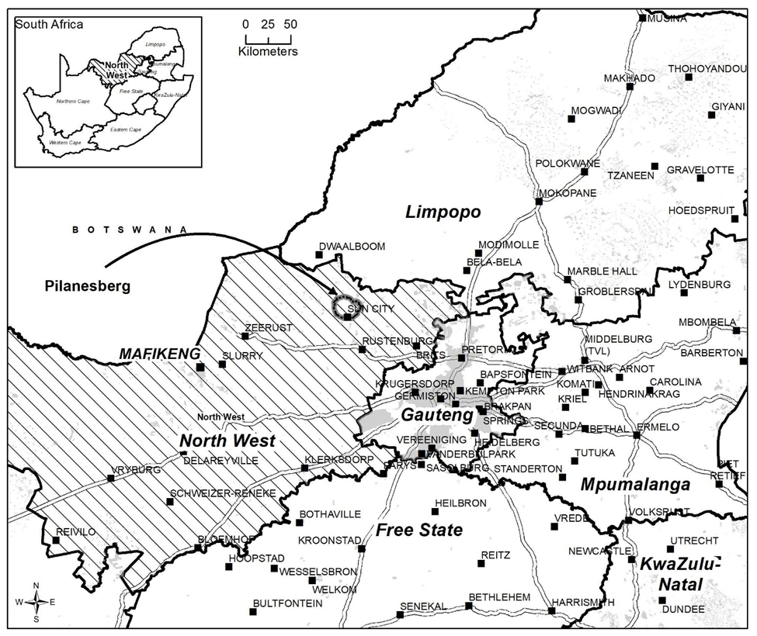

Slide 56
The Pilanesberg National Park (PNP)
Currently the park houses different accommodation options
Eight accommodation options are found within the park boundaries
One private company currently has concession to conduct game drives in the park, aside from the lodges and neighbouring Black Rhino Reserve lodges.
Evaluation of the extent of SMME engagement will be carried out in two opposite forms:
Demand Side Analysis – the consumers of SMME services
Supply Side Analysis – the suppliers of SMME services

Slide 57
Study Approach: Mixed Methods
Demand Side - Qualitative
Focus on the perceptions and processes of the asset: PNP
In-depth interviews with: Procurement managers and/or general managers of all facilities; Park manager; CEO of NWPB; Procurement director of NWPB
Supply Side – Qualitative and Quantitative
Interviews with black SMME owners in the area.
Interviews with SMME Support stakeholders in the Pilanesberg area.
Survey of 277 black-owned SMMEs.

Slide 58
THE PILANESBERG STUDY: Key Findings: The Demand Side (DD)

Slide 59
Facilities in the Pilanesberg National Park

Slide 60
Pilanesberg Key Findings (DD) - Ownership Structure
The vast majority of the facilities found in the park are privately owned and those which are state-owned are privately managed.
All the privately-owned lodges are located on state-owned land with leases for various durations
The land is still state-owned and upon termination of the leases, the lodges would become state property
The only facilities which are managed in the park itself are the hides, lookout points and picnic spots as well as the roads, fences, watering holes and entrances

Slide 61
Pilanesberg Key Findings (DD) - Procurement within the PNP
The Park
All procurement goes through the NWPB head office in Mahikeng.
All suppliers must be registered on the CSD
Work on a 3-quote system for all goods and services under R500,000
Park manager/facilities manager primarily in charge for all goods and services under R300,000 but still processes through NWPB head office
For all goods and services over R500,000, a formal tender is generated and advertised for public bids
Overseen by several committees and final approval given by adjudication authority

Slide 62
Pilanesberg Key Findings (DD) - Procurement within the PNP
State-owned Privately-Managed Lodges
Completely autonomous from the NWPB itself
In Management Company 1, who operates the resorts, the NW government is a shareholder, so procurement processes is more rigorous
For the Centre, which is managed by Management Company 2, completely independent, has their own processes, very unregulated
Privately-owned Lodges
Completely autonomous from NWPB
The larger companies have their own procurement procedures and databases.
The last company is smaller and most of the purchasing is done based on price and relatively ad-hoc – a lot in Rustenburg

Slide 63
Pilanesberg Key Findings (DD) - NWPB Development Initiatives
Policies which govern procurement
Preferential Procurement Legislation
Public Finance Management Act
NW Provincial Government
Villages, Towns and Small Dorpies policy
Dictates that 70% all procurement by state-owned operations must be from companies which fall into this category

Slide 64
Pilanesberg Key Findings (DD) - NWPB Development Initiatives
NWPB Policies
Vague discussions of prioritizing BEE accredited companies
Emphasis on local business
These policies do not apply to the private management companies which manage all the accommodation offerings within North West Parks

Slide 65
Pilanesberg Key Findings (DD) - Goods/Services Procured
Due to remote location of the park, many services are in-sourced
Services outsourced by PNP: Security, Electric fence maintenance, Garden maintenance, Road maintenance
Goods/services outsourced by facilities within the park
Laundry, Game guides, Transport of staff , Transport of guests , Security, Larger construction projects, Maintenance of air conditioners, Pest control, Servicing fire extinguishers, Larger landscaping projects, Interior decorating projects, Some electrical maintenance

Slide 66
Pilanesberg Key Findings (DD) - Links with Local Businesses
Very few use local businesses, even fewer local black-owned businesses
Some do use black-owned businesses but they tend to be larger companies based in major hubs
Lots of discussion of pushes to use local businesses
Some have a few standard suppliers, however tends to be for smaller purchases
Craft one of the primary goods which is sourced locally
Also the use of local performance group(s)

Slide 67
Pilanesberg Key Findings (DD) - Challenges to Using Local Businesses
Conceptualization of “local” often extends to the entire province
Compliance with regulations (VAT registered, etc.)
Distributors not suppliers
Very little primary economic activity which could serve the tourism businesses
Issues with meeting demand
Large inconsistency in supply, particularly of goods
Concerns over ability to complete projects effectively and within a given time frame
For construction projects, etc.

Slide 68
Pilanesberg Key Findings (DD) - Challenges to Using Local Businesses
Issues with necessary quality of goods and level of skills to meet needs of facilities
Small local businesses often need large deposits, however many of the processes enacted by the management companies do not allow for this, park manager also mentioned this as an issue
Much of the local economy is still structured around the mines and serving the mines
Tourism appears to play a much less significant role at present

Slide 69
THE PILANESBERG STUDY: Key Findings: The Supply Side (SS)

Slide 70
Areas Covered in the Survey

Slide 71
Pilanesberg Key Findings (SS) - SMME Business Characteristics
Retail industry concentration of SMMEs, does not reflect the mining and tourism specialisation of the area revealing that local black-owned SMMEs are not very engaged in the key sectors that drive the local economy.
Clientele base: Local SMME economy that is primarily driven by local resident’s consumption. This further demonstrates non-engagement in the core commercial industry in the area.
This is not sustainable in the long-run as Surveyed black-owned SMMEs employ about 850 employees.
Notes:
This conservative figure is calculated by multiplying the lower-bound for each range by the frequency, except for the ‘0 to 4’ range where the median value (i.e., 2) is used. The categories ‘more than 200’ and ‘no response’ are excluded from the analysis. [(2 x 208) + (5 x 27) + (10 x 25) + (50 x 1)] = 851

Slide 72
Pilanesberg Key Findings (SS) - SMME Engagement in State procurement
Black-owned SMME engagement is almost non-existent.
Significant gap between the activities of the government agencies and assets in the area (including private tourism establishments) and the black-owned SMME economy.
Less than 30% of SMMEs report being registered on any suppliers’ database.
About 77% of respondents have never competed for a government tender.
About 81% of respondents report not having any business or even support relationships with government establishments.
About 75% report NOT having any business relationships with the lodges and tourism establishments in the area.

Slide 73
Table: SMME Engagement in State procurement
Experience competing for a tender | Frequency | % | Cumulative %
I have never competed for a tender | 213 | 76.90 | 76.90
I have competed but did not get it | 28 | 10.11 | 87.00
I have competed and got it | 19 | 6.86 | 93.86
No response | 17 | 6.14 | 100.00
Total | 262 | 100.00
Government Relationship (Business and/or Support)
Yes | 19 | 6.86 | 6.86
No | 224 | 80.87 | 87.73
No response | 34 | 12.27 | 100
Total | 277 | 100
Do you supply any of the lodges or tourism attractions in the area?
Yes | 62 | 22.38 | 22.38
No | 207 | 74.73 | 97.11
No response | 8 | 2.89 | 100
Total | 277 | 100

Slide 74
Pilanesberg Key Findings (SS) - Reasons for Low black SMME Engagement
Lack of information
on the entire tender/contract process (n=36)
on partnership opportunities with bigger firms (n=13)
Lack of awareness
of opportunities (of the type of services the government requires (n=24)
of the existence of suppliers’ databases. (n=98)
Lack of interest
in obtaining government contracts. (n=28)
in engaging with private firms. (n=22)

Slide 75
Pilanesberg Key Findings (SS) - Reasons for Low black SMME Engagement
Lack of access to larger businesses in the area - unwilling to do business on their part, or make the process of any partnership difficult, thereby discouraging such engagement (n=50)
Lack of trust in government - belief that the government structures are not transparent (n=24)
Inadequate capacity - often referring to funding limitations to grow their business (including manpower) to the level required to partner with these bigger businesses (n=35), and to supply the government (n=11)

Slide 76
Pilanesberg Key Findings (SS) - SMME Attitude to Business Development and External linkages
Lack of awareness and information and Lack of interest is indicative of a more general attitude of ‘disconnect’ from the business environment in the Pilanesberg.
Consequently, the overall attitudes of the SMMEs to business development and external linkages were further interrogated.
Specifically, engagement with business support structures and enterprise development initiatives put in by government and private sector. [e.g. The Pilanesberg Tourism Incubator; Bakgatla Ba Kgafela Development and Welfare company; Royal Bafokeng Enterprise Development; and The Provincial LED office).
Engagements: <15% in business support; <30% in SMME training.

Slide 77
Table: SMME Attitude to Business Development and External linkages
Worked with Government/Private Support Agency | Frequency | Percent
No | 222 | 80.14
Yes | 29 | 10.47
No response | 26 | 9.39
Total | 277 | 100
Participated in SMME training?
No | 186 | 67.15
Yes | 80 | 28.88
No response | 11 | 3.97
Total | 277 | 100

Slide 78
Pilanesberg Key Findings (SS) - Reasons for low support uptake
Lack of awareness of the support initiatives (about 52%)
Lack of information on the business trainings/seminars (36% of responders).
Disinterest in, and perceived irrelevance of the support and training programmes (29% for support and 15% for trainings).
The idea that ignorance of opportunities is the main problem in this area is re-iterated: the majority of respondents self-trained and self-funded their business (only 1% reporting obtaining training from government incubator program and <1% reporting obtaining start-up funding from the government).

Slide 79
THE PILANESBERG STUDY: Key Conclusions

Slide 80
Pilanesberg: Key Conclusions
The local economy seems only to benefit from the key economic sectors - mining and tourism - via the channel of jobs created for individuals by the privately-owned large companies (especially in mining) which dominate these sectors.
Problematic because of the decreasing role that mining is playing in economic development in South Africa.
Disconnect between the NWPB’s proposed SMME development policies and the actual procurement procedures due to management structure and the current policy climate.

Slide 81
Pilanesberg: Key Conclusions
Private tourism assets sparingly use local SMMEs – even fewer black-owned ones. Primarily due to limited primary production in the area, issues of quality assurance, and issues of capacity to meet demand.
A sense of complacency with business can also be deduced from the high level of disinterest in government contracts, engaging with bigger businesses, registration with suppliers’ databases, and in business development initiatives.
It suggests that a significant proportion of the black-owned SMMEs are not interested in growing their businesses beyond the local economy and are content to provide ‘support’ services to the workers in the mining and tourism industry.

Slide 82
THE PILANESBERG STUDY: Preliminary Recommendations

Slide 83
Pilanesberg: Preliminary Recommendations
To improve the policy environment:
When creating or renewing leases or awarding tenders for the management of facilities with the Pilanesberg, the NWPB should develop contracts which requires them to meet certain standards with regards to utilizing local SMMEs.
NWPB should reconsider the way that existing traversing rights are granted to tourism operators wishing to establish businesses which take visitors into the park.

Slide 84
Pilanesberg: Preliminary Recommendations
To develop SMME capacity in the Pilanesberg area:
Focus should FIRST be on re-orientating SMME attitudes to external linkages. This could be through partnership with the local authorities.
Developing specific training in a wide range of specialized skill sets might be a useful way for leveraging the park for local SMME development (e.g. game guiding, servicing equipment, etc.).
Develop a food co-op structure to increase the ability of local suppliers to meet the demand of the tourism facilities.

Slide 85
Pilanesberg: Preliminary Recommendations
To address the dominant issue of lack of awareness/information, the government would need to invest in exposure and infrastructure development (roads and internet) to allow people easily access information on opportunities. This can, also, help correct the negative perceptions of government as it will allow for correct and informed information accumulation and dissemination.

Slide 86
UJ PROJECT: Summary of Main Findings from dual study

Slide 87
Summary Findings
This is Year 1 of the proposed 3 year UJ project on leveraging state assets for inclusive tourism and promoting black SMME development.
The findings from Overstrand and Pilanesberg show that there are both opportunities and challenges for leveraging a range of state assets.
The lesson from Overstrand is of rich potential municipal assets which are underperforming and not being maximised for tourism.
The Pilanesberg study reveals more complex issues around the need for to re-orientate the local policy environment in order to achieve a more inclusive local tourism economy.

Slide 88
Ngiyabonga Dankie Thank You

